Slide 1
Seeing the Impossible Visualizing Latent Variable Models with flexplavaan
Dustin Fife
Steven Brunwasser
Ed Merkle

Slide 2
What is flexplavaan?

Slide 3
flexplavaan = flexplot + lavaan

Slide 4
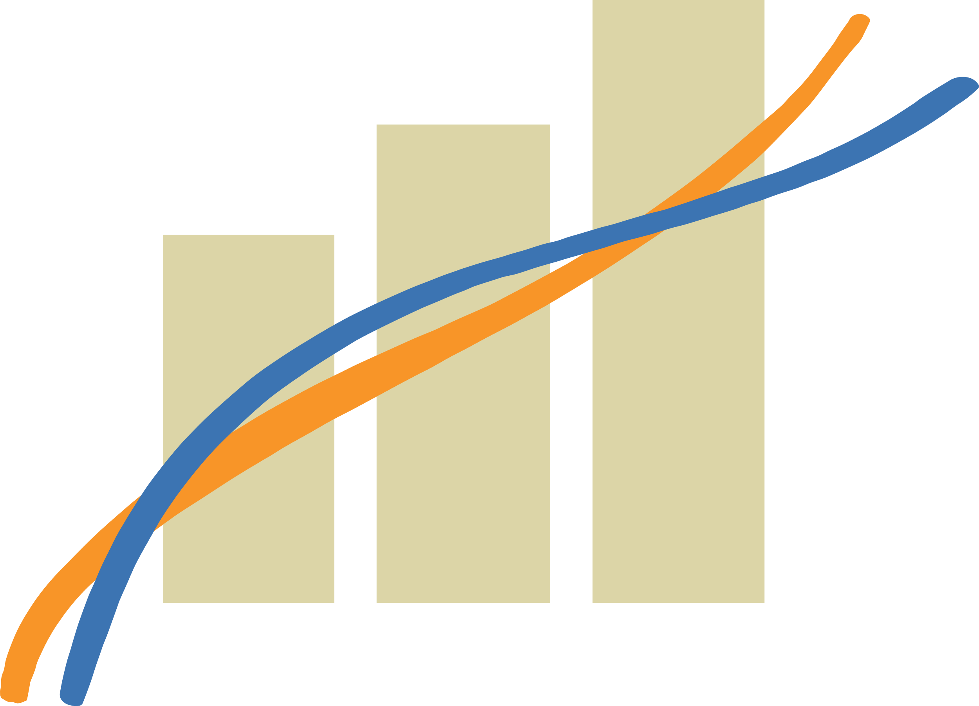
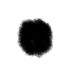
What is Flexplot?
Flexible Plotting
User specifies a model
Flexplot visualizes that model automatically
Emphasis on raw data

Slide 5
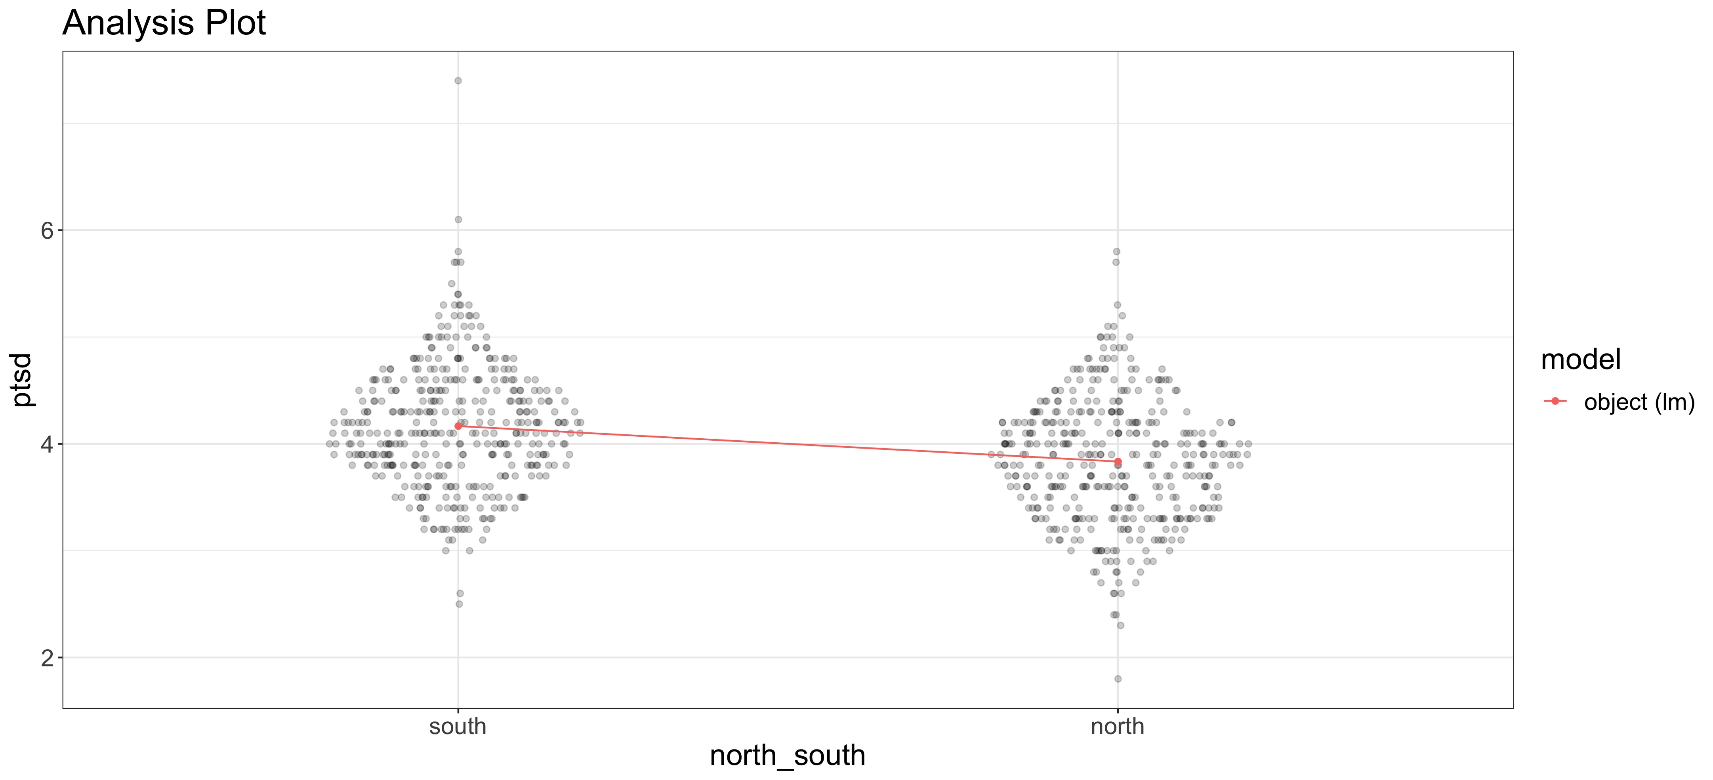
T-Test

Slide 6
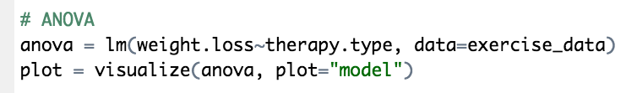
ANOVA

Slide 7
Regression

Slide 8
Mixed Models

Slide 9
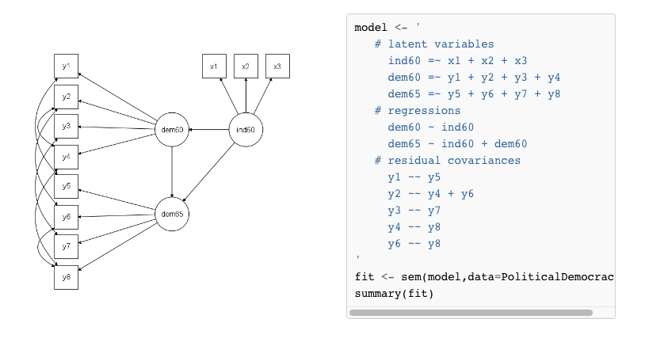
What is lavaan?
Latent Variable Analysis
Use observed variable
To hypothesize latent variables
Software for structural equation models

Slide 10
So...
flexplot + lavaan = flexplavaan
OR
easy plots +latent variable models = flexplavaan

Slide 11
So...
flexplot + lavaan = flexplavaan
OR
easy plots +latent variable models = flexplavaan
Flexplavaan is a software package for visualizing LVMs

Slide 12
But, there’s a problem!

Slide 13
Visualizing Latent Variable Models
They’re invisible!
Raw data??
Covariances

Slide 14
Jedi Example – Assumed Model

Slide 15
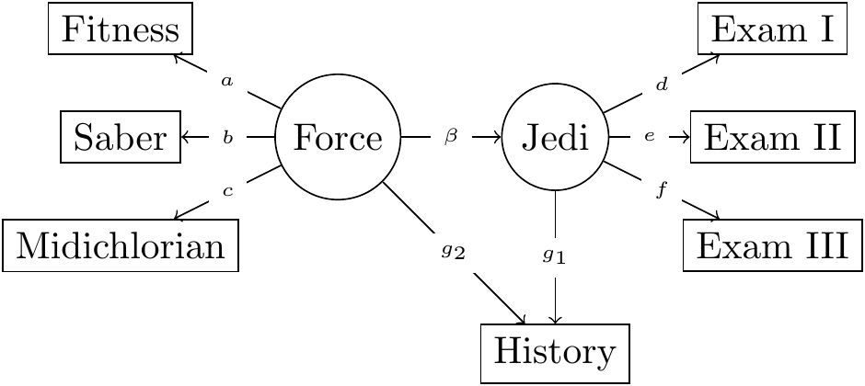
Jedi Example – Correct Model

Slide 16
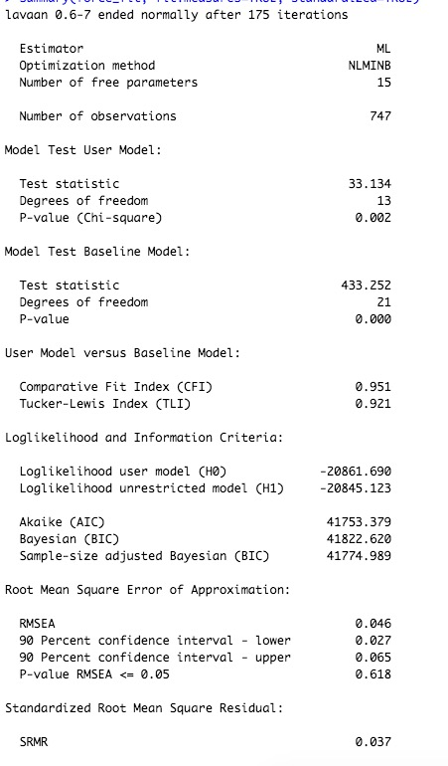
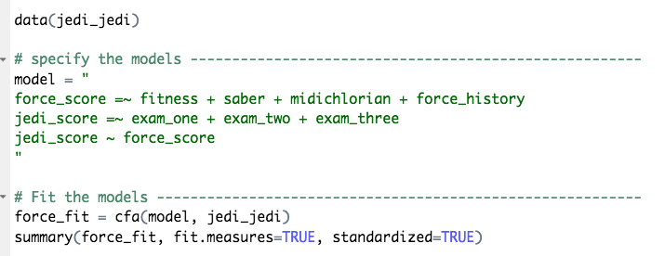
Naïve Analysis

Slide 17
Visualization method
Plot observed variables against observed variables
Overlay the fit implied by the model

Slide 18
The visuals?
Scatterplot matrix of observed variables
Use implied covariance to estimate the “slope”

Slide 19
We can do better
Disturbance-Dependence Plots
Subtract effect of the model
If any “signal” remains, our model has problems

Slide 20
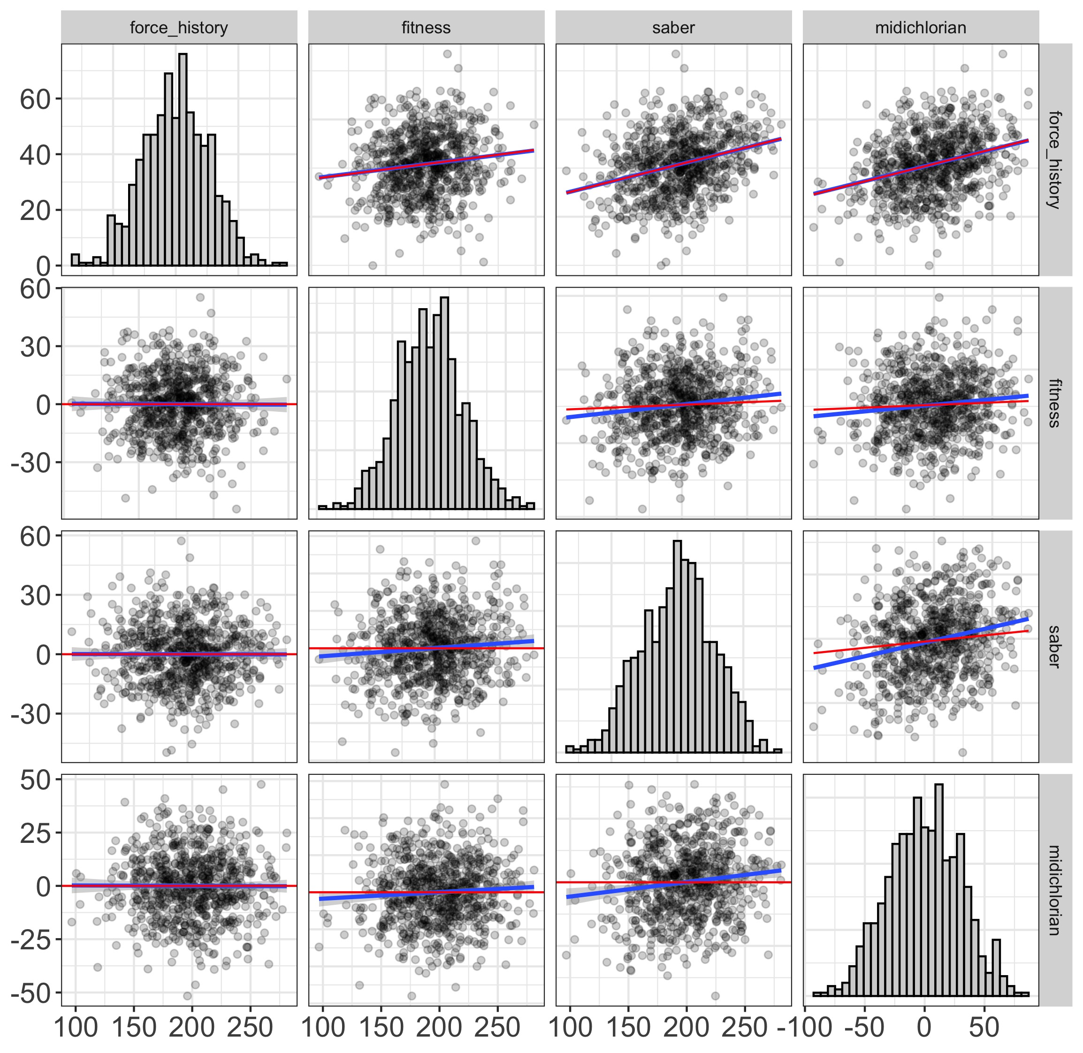
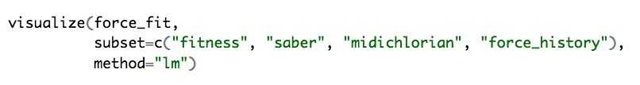
Disturbance-Dependence Plots

Slide 21
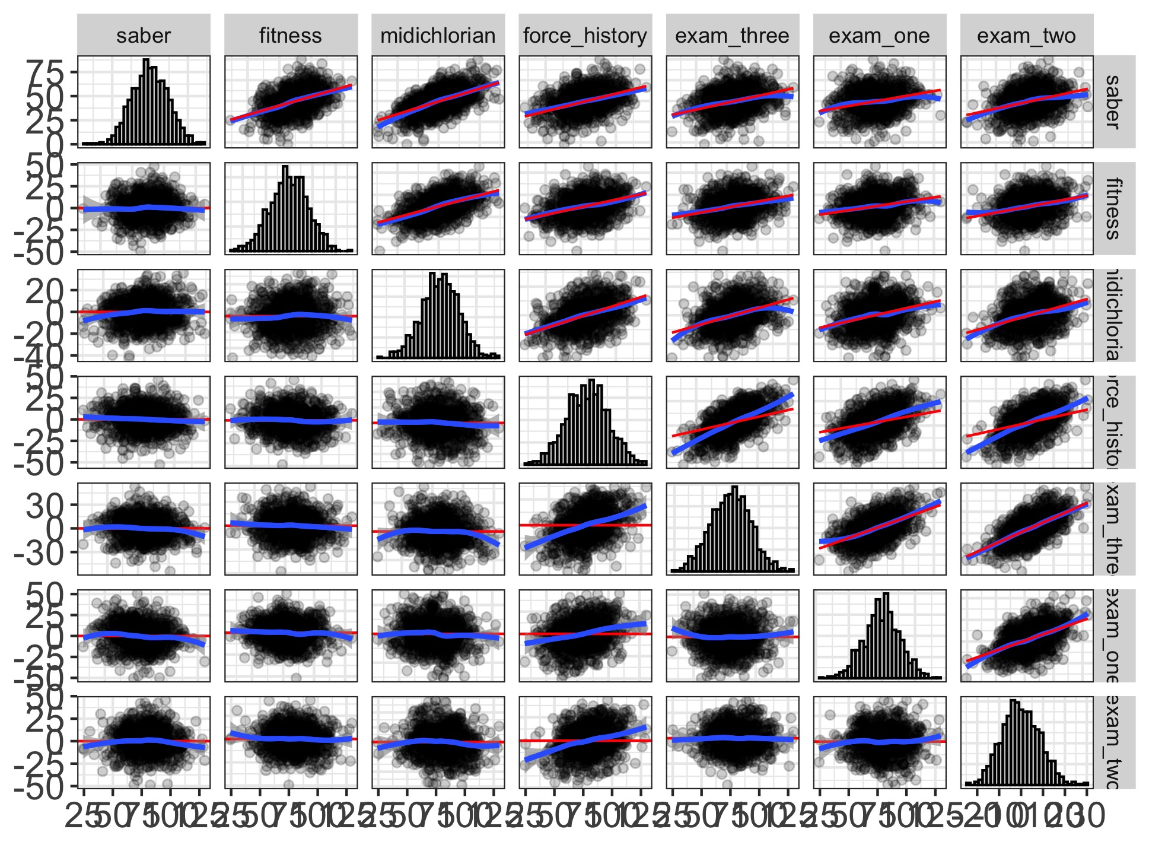

Or the whole model together...

Slide 22
But that’s not enough...

Slide 23
But that’s not enough...
Sometimes misfit doesn’t show up in correlations...
...but in the latent variables

Slide 24
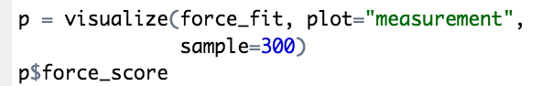
We can also visualize the measurement model...

Slide 25
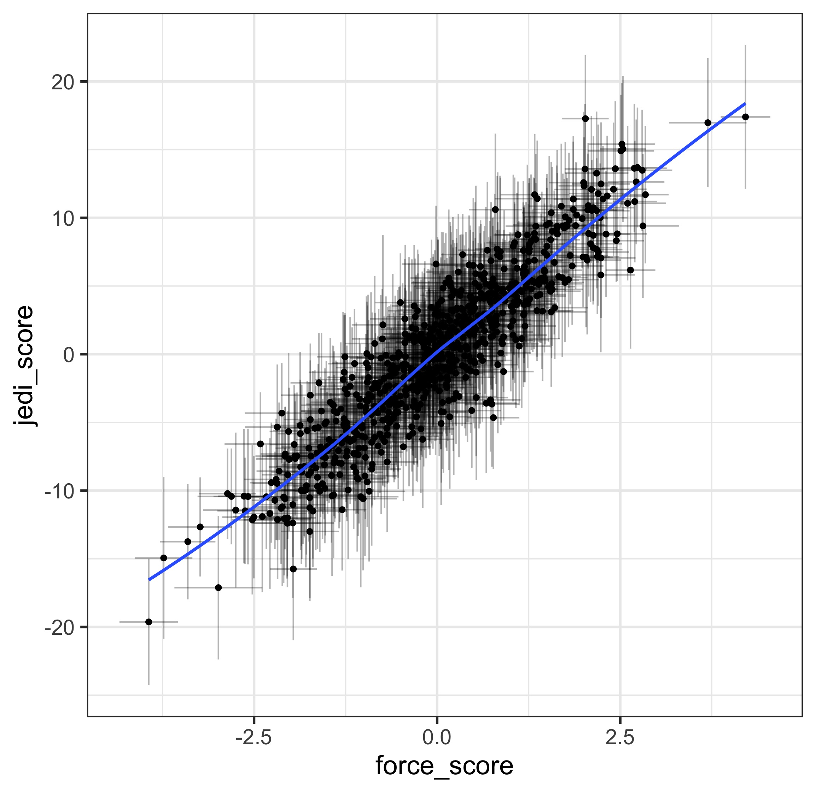
And the structural model...

Slide 26
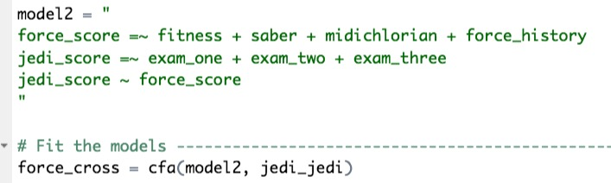
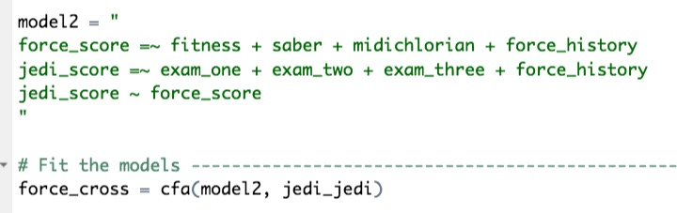
Let’s compare the two models

Slide 27
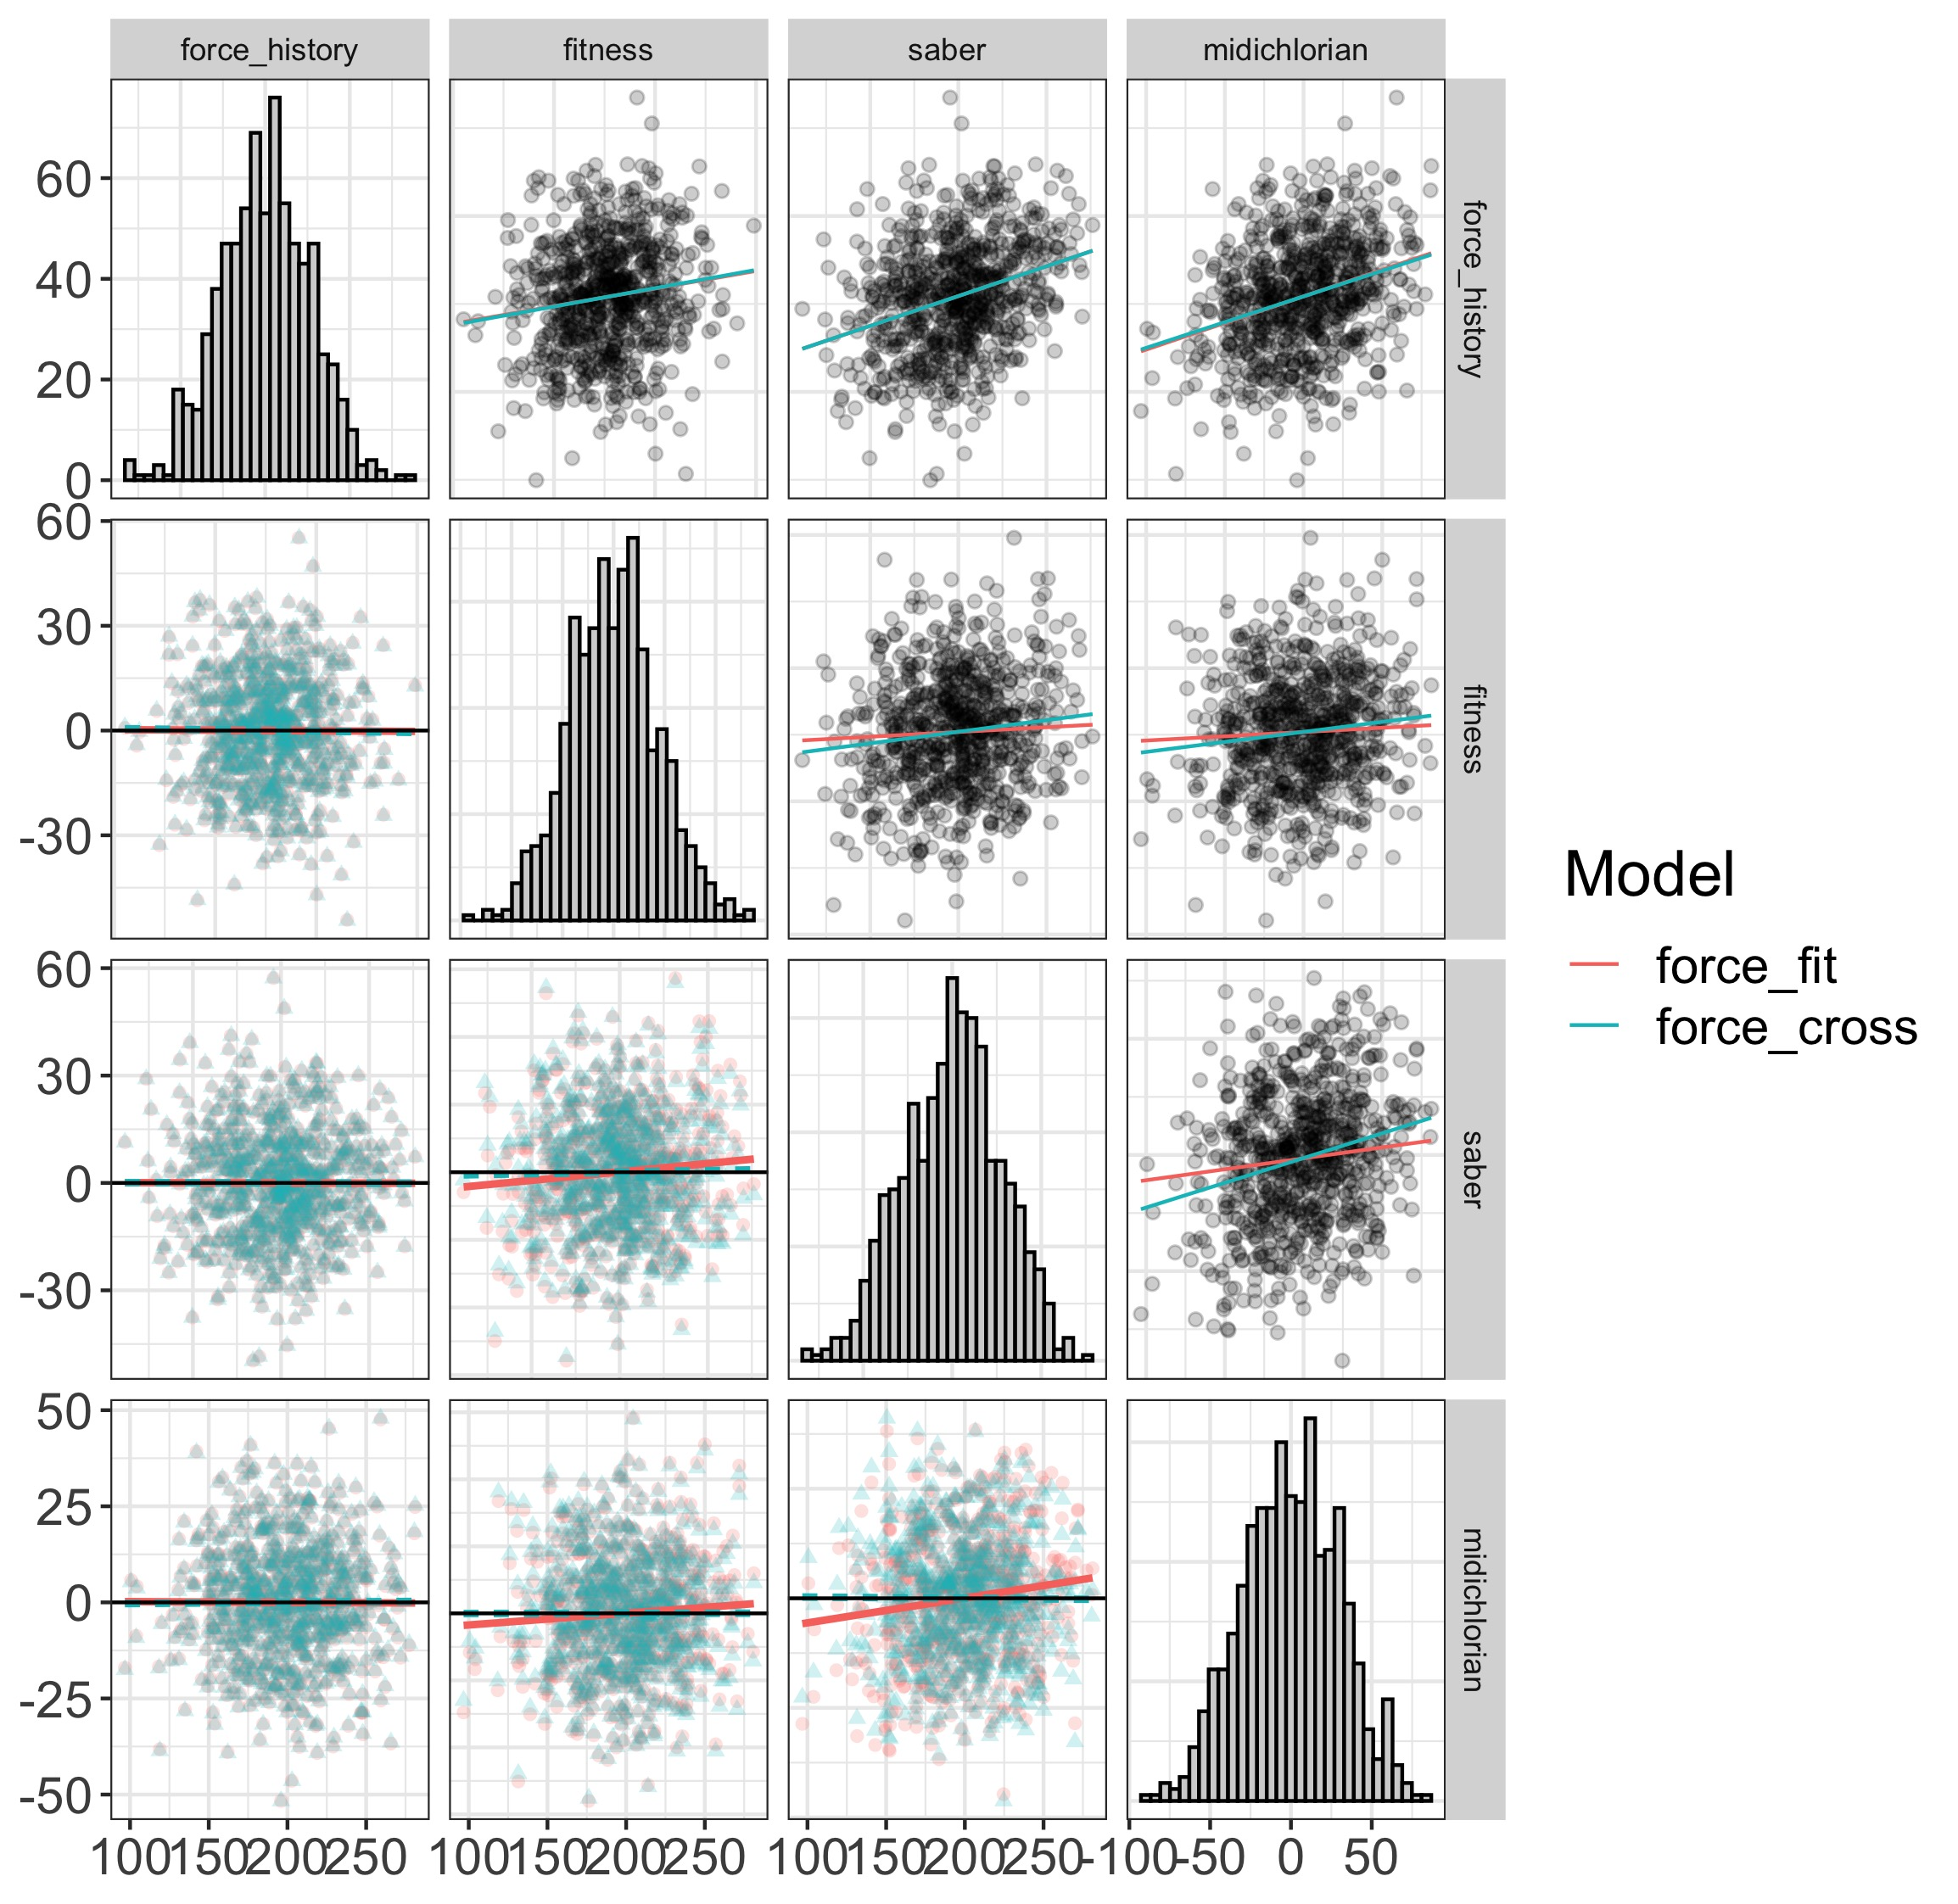
Visually comparing models

Slide 28
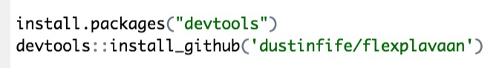
Where to get it?
All in github repository
github.com/dustinfife/flexplavaan

Slide 29
Where to read about it?
Fife, D., Brunwasser, S., & Merkle, E. C. (in press). Seeing the Impossible: Visualizing Latent Variable Models with flexplavaan. Psychological Methods. https://doi.org/10.31234/osf.io/qm7kj

